Slide 1
All About Unit Testing
Presented by QC Coders

Slide 2
What Is Unit Testing?
UNIT TESTING is a level of software testing where individual units/ components of a software are tested.
The purpose is to validate that each unit of the software performs as designed.
A unit is the smallest testable part of any software. It usually has one or a few inputs and usually a single output.
In procedural programming, a unit may be an individual program, function, procedure, etc.
In object-oriented programming, the smallest unit is a method, which may belong to a base/ super class, abstract class or derived/ child class.
http://softwaretestingfundamentals.com/unit-testing/

Slide 3
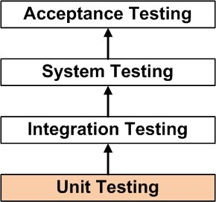
What About Other Types of Testing?

Slide 4
What About Other Types of Testing?
Unit Testing
Tests the smallest testable parts of software
Primary audience: developers
Integration Testing
Tests two or more units
Primary audience: senior/lead developers
System Testing
Tests whether the integrated software works together
Primary audience: leads, architects, business analysts
Acceptance Testing
Tests whether the software system as a whole meets business requirements
Primary audience: stakeholders, product owner

Slide 5
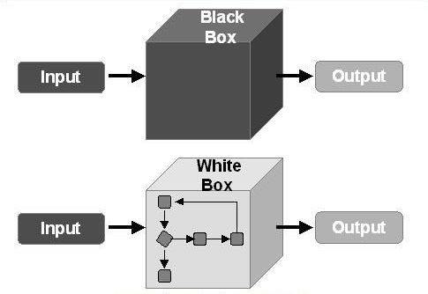
What Methods Can We Use to Unit Test?

Slide 6
Black Box Testing
BLACK BOX TESTING, also known as Behavioral Testing, is a method in which the internal structure/design/implementation of the item being tested is not known to the tester. These tests can be functional or non-functional, though usually functional.
Advantages
Tests are done from a user’s point of view and will help in exposing discrepancies in the specifications.
Testers don’t need to know implementation details, and testing can be completed by a separate team/individual, helping to eliminate bias
Test cases can be designed by testers, analysts, stakeholders, anyone other than the developers
Disadvantages
The range and complexity of inputs is limited to the testers’ imagination (or a test data generator) and therefore may not exercise all code paths
Test cases are difficult or impossible to define properly if specifications are lacking (most of the time)

Slide 7
White Box Testing
WHITE BOX TESTING is a method in which the internal structure/design/implementation of the item being tested is known to the tester. The tester chooses inputs to exercise paths through the code and determines the appropriate outputs.
Advantages
Testing can be performed at earlier stages, perhaps before code is even written
Testing is more thorough and succinct
Test efficacy can be measured empirically with code coverage
Disadvantages
Skilled testers are required; most likely the same developers that wrote the software
When the code changes, so must the tests
Deriving business value may be difficult for code which won’t be around long, or which is not ‘line of business’

Slide 8
Applying White Box/Black Box Methods
Generally speaking, use a white box methodology for unit tests and black box for everything else
Less generally speaking:
Write ‘white box’ unit tests for shared code (libraries, etc)
Use code coverage as a metric to test what you haven’t tested (shoot for 90-95%)
Try to limit the complexity of software layers containing business logic so that integration testing has a higher likelihood of covering all code paths (eliminating the need to unit test business logic)
Use tests as feedback for your code:
Having trouble writing a test to hit a particular branch? Maybe you don’t need that branch.
Are a lot of tests passing through the same branch? Maybe you should move that logic elsewhere.
Finding yourself testing things that have already been tested for another class? Maybe you’re doing too much error handling.

Slide 9


Applying White Box/Black Box Methods
Use your head, be pragmatic, let go of dogmatic thought patterns, and focus on deriving business value

Slide 10
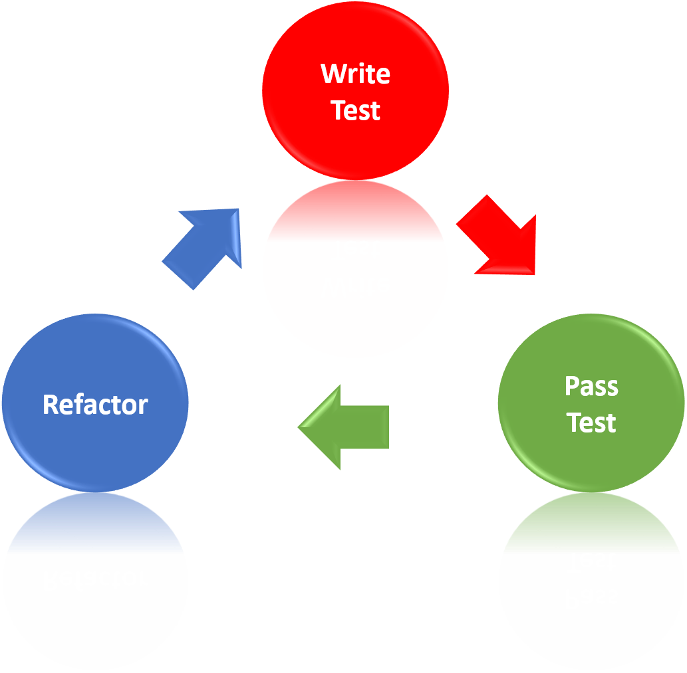
What About Test Driven Development?

Slide 11
What About Test Driven Development?
Consider your environment
How big is your team?
How big is your organization?
Is everyone in the same spot physically? In the same time zone? In the same country?
How diverse is your team in terms of experience level? Any other aspects?
Consider your system
How large/complex is the system you’re working on?
How old is your system?
Consider your goals
Are you working for a startup? Adding features to an enterprise application? Maintaining legacy code?
As the overall picture becomes more complex, difficulty in keeping everyone ‘pulling in the same direction’ increases. TDD can help.

Slide 12
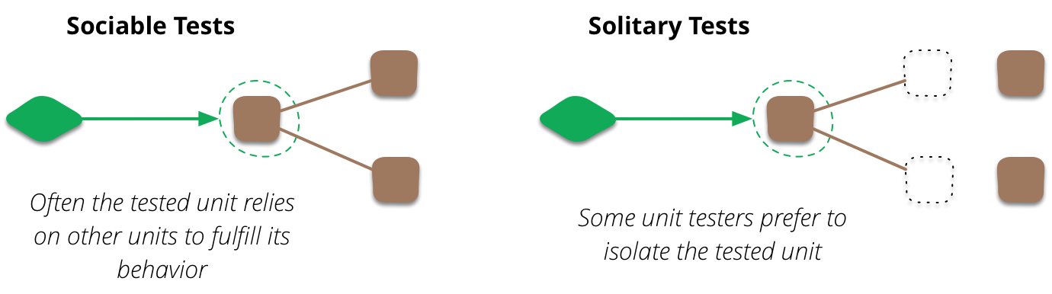
Unit Testing Strategy

Slide 13
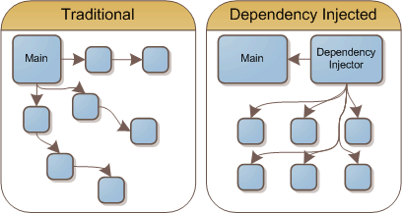
Unit Testing Strategy

Slide 14
Questions?

